Slide 1


Department of Computer Science & Engineering
“Academic Project Management and Evaluation System for NBA-Accredited, VTU-Affiliated Institutions”
Team Members:
Bhavani(3GN22CS021)
Neha(3GN22CS058)
Bhagyashri(3GN22CS017)
Ashwini(3GN23CS401)
Under the Guidance of : Prof.Sandeep Iddalgave

Slide 2

Introduction
Managing final-year projects manually is often time-consuming and prone to errors. Faculty face challenges in evaluating projects consistently and assigning guides based on expertise, while students struggle to track their performance across different evaluation components. Institutions find it difficult to maintain centralized records, prevent topic duplication, and generate accurate reports efficiently. Academic Project Management and Evaluation System for NBA-Accredited, VTU-Affiliated Institutions provides a web-based platform that streamlines project management, automates evaluation, facilitates effective guide assignment, and generates standardized reports, improving transparency, accuracy, and overall productivity for both faculty and students.

Slide 3
Problem Statement:
In academic institutions, the manual process of project allocation and evaluation often leads to mismatches between student interests and faculty expertise, repetition of project topics, and inefficient tracking of progress.
Key Issues:
Manual evaluation leads to:
  Errors in marks calculation and duplication.
  Lack of proper guide assignment considering expertise.
  Lack of centralized tracking for projects.
  Inefficient generation of individual reports.
Goal: Build a web-based system to automate evaluation, generate Excel reports, and improve transparency.

Slide 4
Literature Review
S .No | Title | Author | Publication | Year | Techniques Used | Key Findings
1 | A Web-Based Academic Project Management and Evaluation System | S. S. Pandey et al. | IRJMETS | 2025 | Role-based web app (Flask); digital submission, online evaluation | Enabled digital project submission and guide feedback; reduced paperwork and improved transparency.
2 | Student Performance Evaluation System | A. D. Shirale & K. T. Mali | IJNRD | 2024 | Data analytics + ML for evaluation | Automated student performance tracking; improved accuracy and reduced bias.

Slide 5
S .No | Title | Author | Publication | Year | Techniques Used | Key Findings
3 | Web-Based Projects Evaluation Management System | M. O. Oyelami & J. B. Odajuyigbe | IEEE | 2008 | Online evaluation forms; design-research methodology | Digitized project evaluation; saved time and enhanced accessibility.
4 | Student Project-Management and Evaluation Strategies | W. K. Wanyoike & M. N. Mwangi | IJRPR | 2023 | Survey + requirement analysis | Highlighted gaps in existing tools; recommended integrated evaluation platforms.

Slide 6
S .No | Title | Author | Publication | Year | Techniques Used | Key Findings
5 | Quality Evaluation System for Higher-Ed Students | C. L. T. Dang & S. Zhang | IJELS | 2024 | Statistical modeling + survey | Proposed fair, multi-factor academic evaluation; validated high feasibility.
6 | Distributed Student Performance Assessment System | A. Montoya & D. Jiménez | Preprint | 2024 | Agile dev + DB replication | Achieved efficient, transparent assessment with real-time monitoring.

Slide 7
S .No | Title | Author | Publication | Year | Techniques Used | Key Findings
7 | Academic Project Nexus: Final-Year Project Management System | R. A. Helonde et al. | IRJMETS | 2024 | Web app (HTML, CSS, MySQL); authentication | Centralised repository promoting collaboration and secure documentation.
8 | Responsive Web-Based Final-Year Project Repository (FYPRS) | O. I. Uzugogbo & A. M. Kolade | WJAETS | 2024 | Laravel framework; usability testing | Simplified project submission + evaluation; proved high user adoption.

Slide 8
S .No | Title | Author | Publication | Year | Techniques Used | Key Findings
9 | University Results Extraction & Analysis Tool | G. Geethalaxmi et al. | IJAEM | 2022 | Node.js + Python; OpenPyXL; batch processing | Automated Excel report generation; minimized manual entry errors.
10 | Electronic Learner Data Management System | M. N. De Guzman et al. | IJRISS | 2024 | SDLC + Agile; TAM evaluation | Improved data accuracy and record retrieval; strong user acceptance.

Slide 9
Summary of Literature Review
Most studies propose web-based systems to manage academic projects and automate evaluations.
Many solutions lack integration between submission, evaluation, and reporting workflows.
Role-based access and centralized data improve transparency and reduce administrative load.
Automation of report generation (e.g., Excel) is still emerging and not widely adopted.
Intelligent guide assignment and domain-based project mapping are rarely explored.
Few systems support bulk reporting or prevent project topic duplication.
PMES addresses these limitations by combining evaluation automation, structured reporting, and intelligent guide allocation.

Slide 10
Objectives
Develop a centralized web-based project evaluation system.
Assign project guides based on expertise and student project domains.
Avoid topic duplication by analyzing previous projects and Maintain a structured database for all project records.
Auto-generate individual Excel reports for each student and Reduce faculty workload and improve transparency.

Slide 11
Design :
System Architecture :
  The System Architecture of the Project Management Evaluation System (PMES) follows a modular, layered design to ensure scalability and maintainability. It consists of three main layers — Presentation Layer, Application Layer, and Data Layer.
  The Presentation Layer provides an intuitive user interface that allows administrators, faculty, and students to interact seamlessly with the system.
  The Application Layer handles the core logic, including project tracking, evaluation processing, and report generation.
  The Data Layer manages storage and retrieval operations using a structured database to maintain project, user, and evaluation data securely.

Slide 12
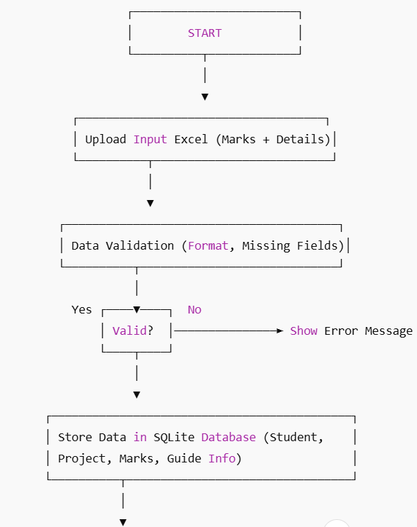
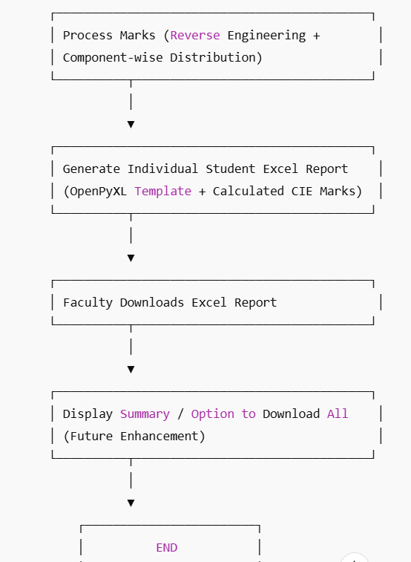
Flow Chart

Slide 13
Implementation
Technology Stack :
Component | Technology
Backend | Python (Flask)
Database | SQLite
Frontend | HTML, CSS
Libraries | Pandas, OpenPyXL etc.
Output | Auto-generated reports

Slide 14
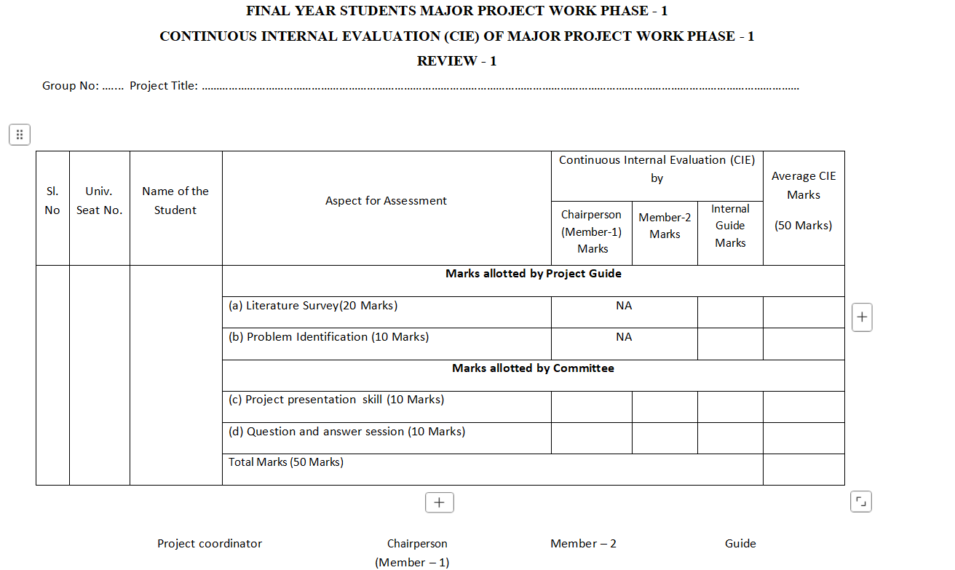

Slide 15
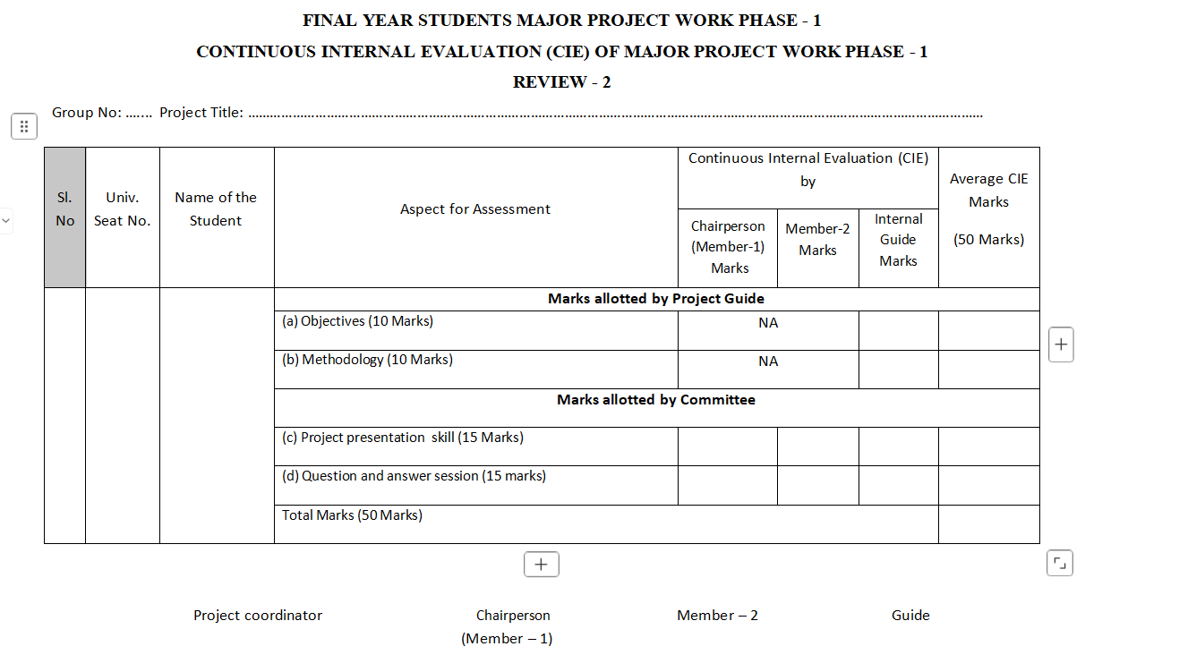

Slide 16
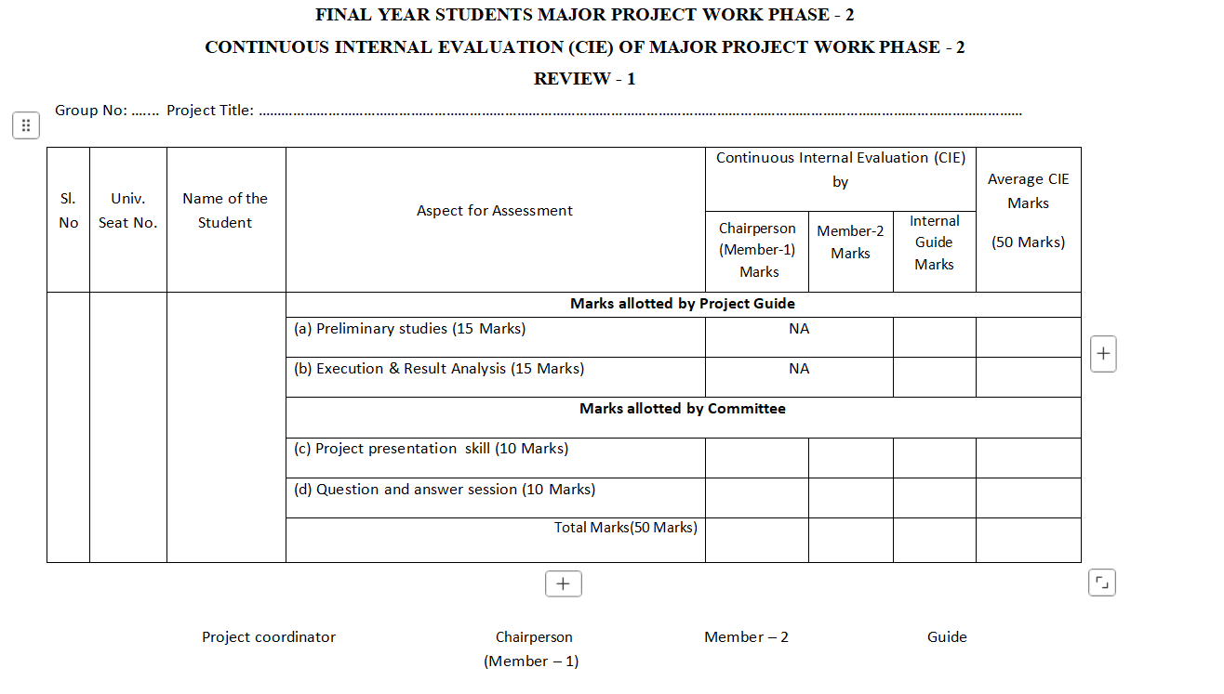

Slide 17
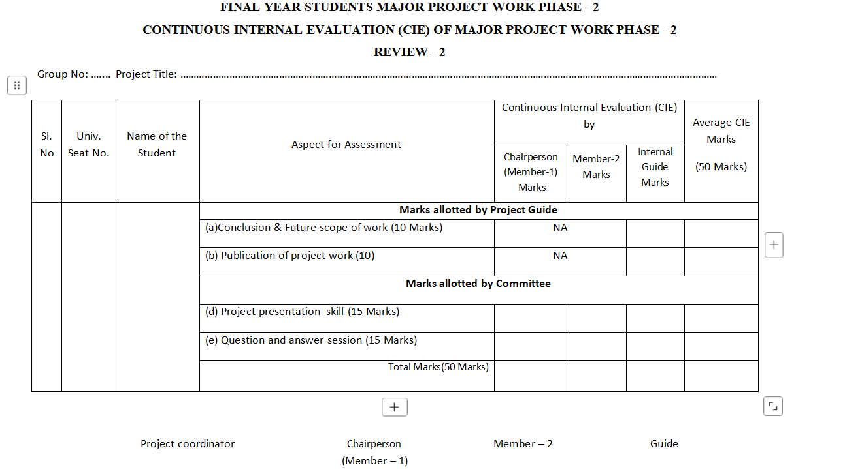

Slide 18
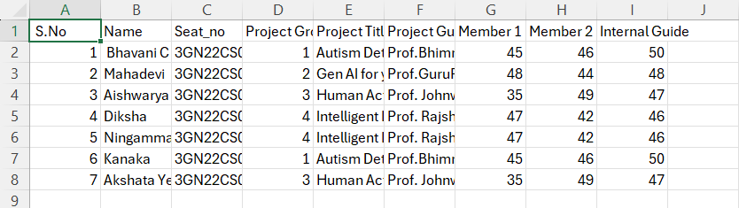
Input Data :

Slide 19
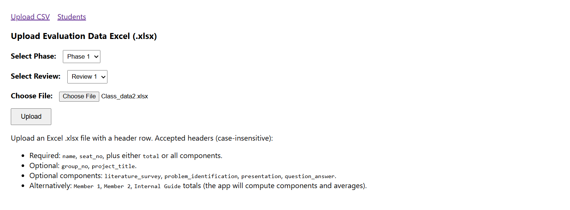

Slide 20
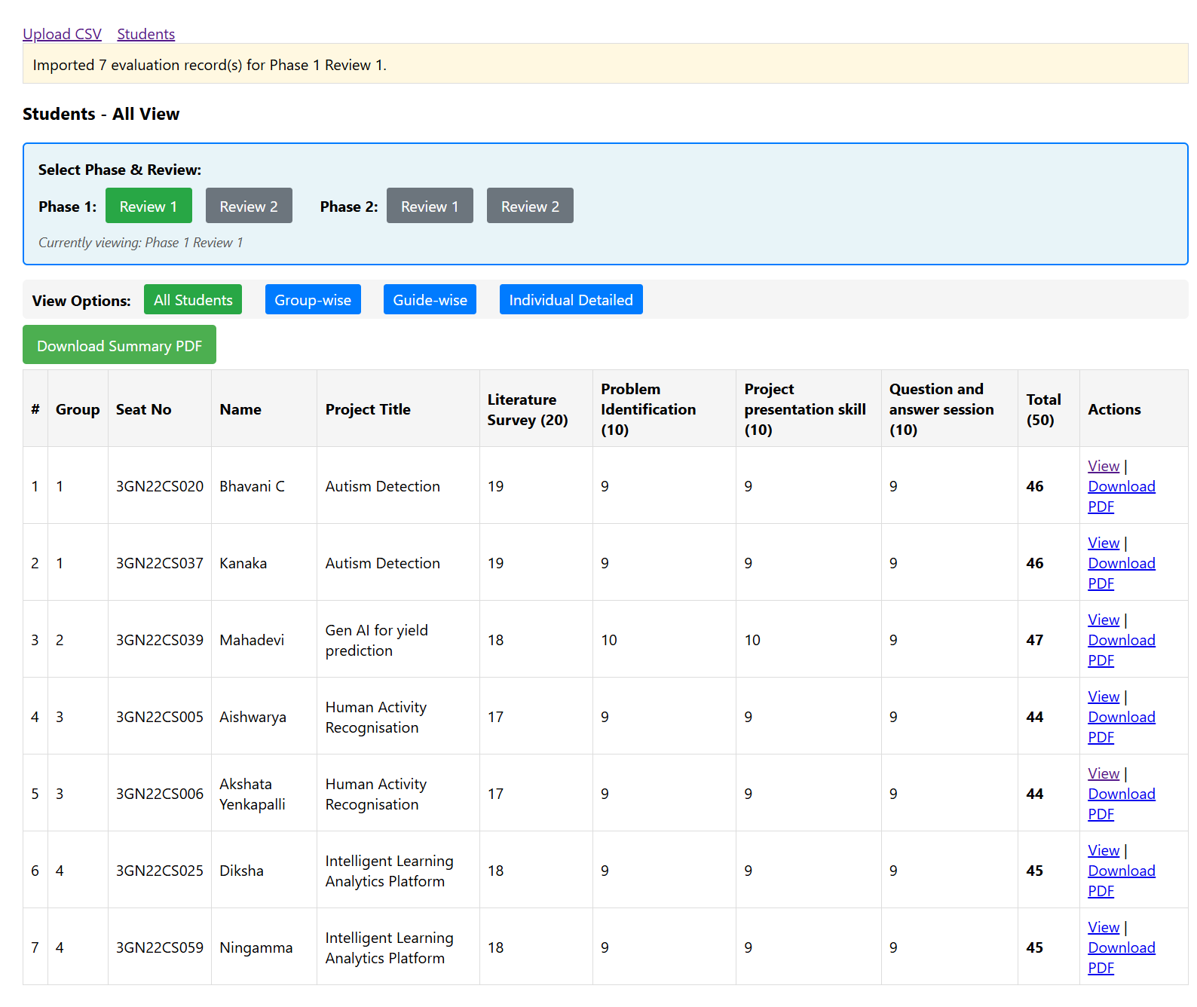

Slide 21
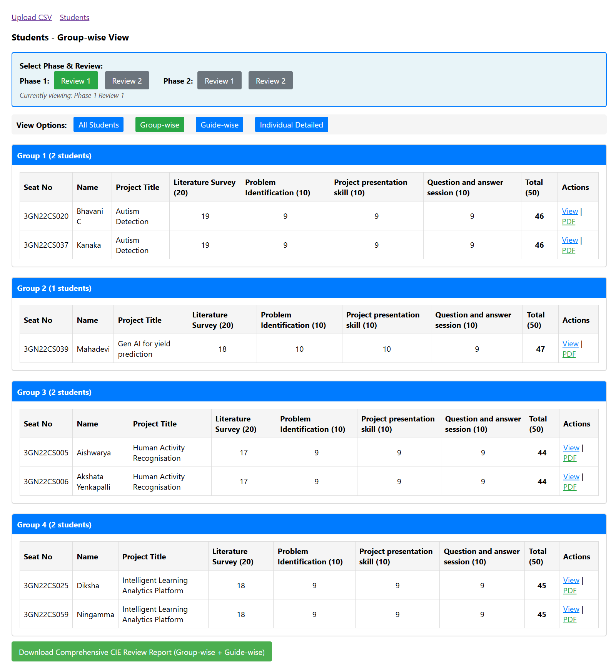

Slide 22
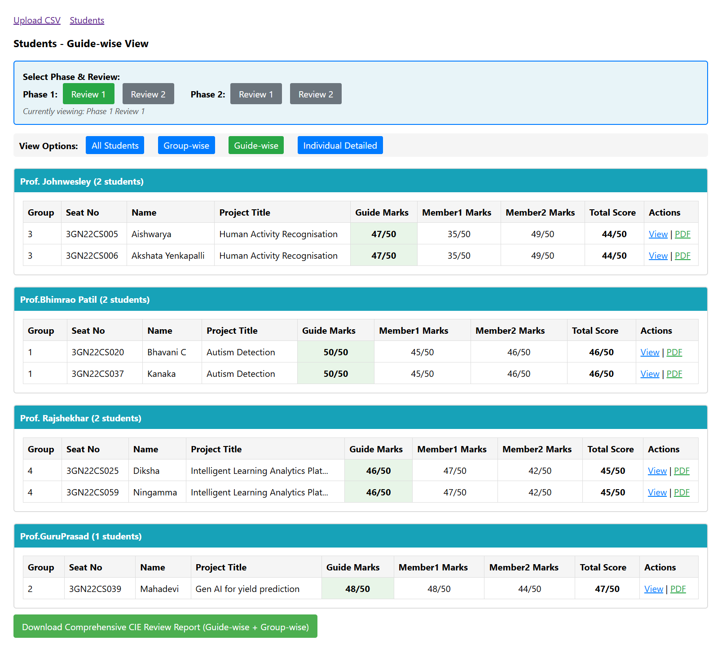

Slide 23
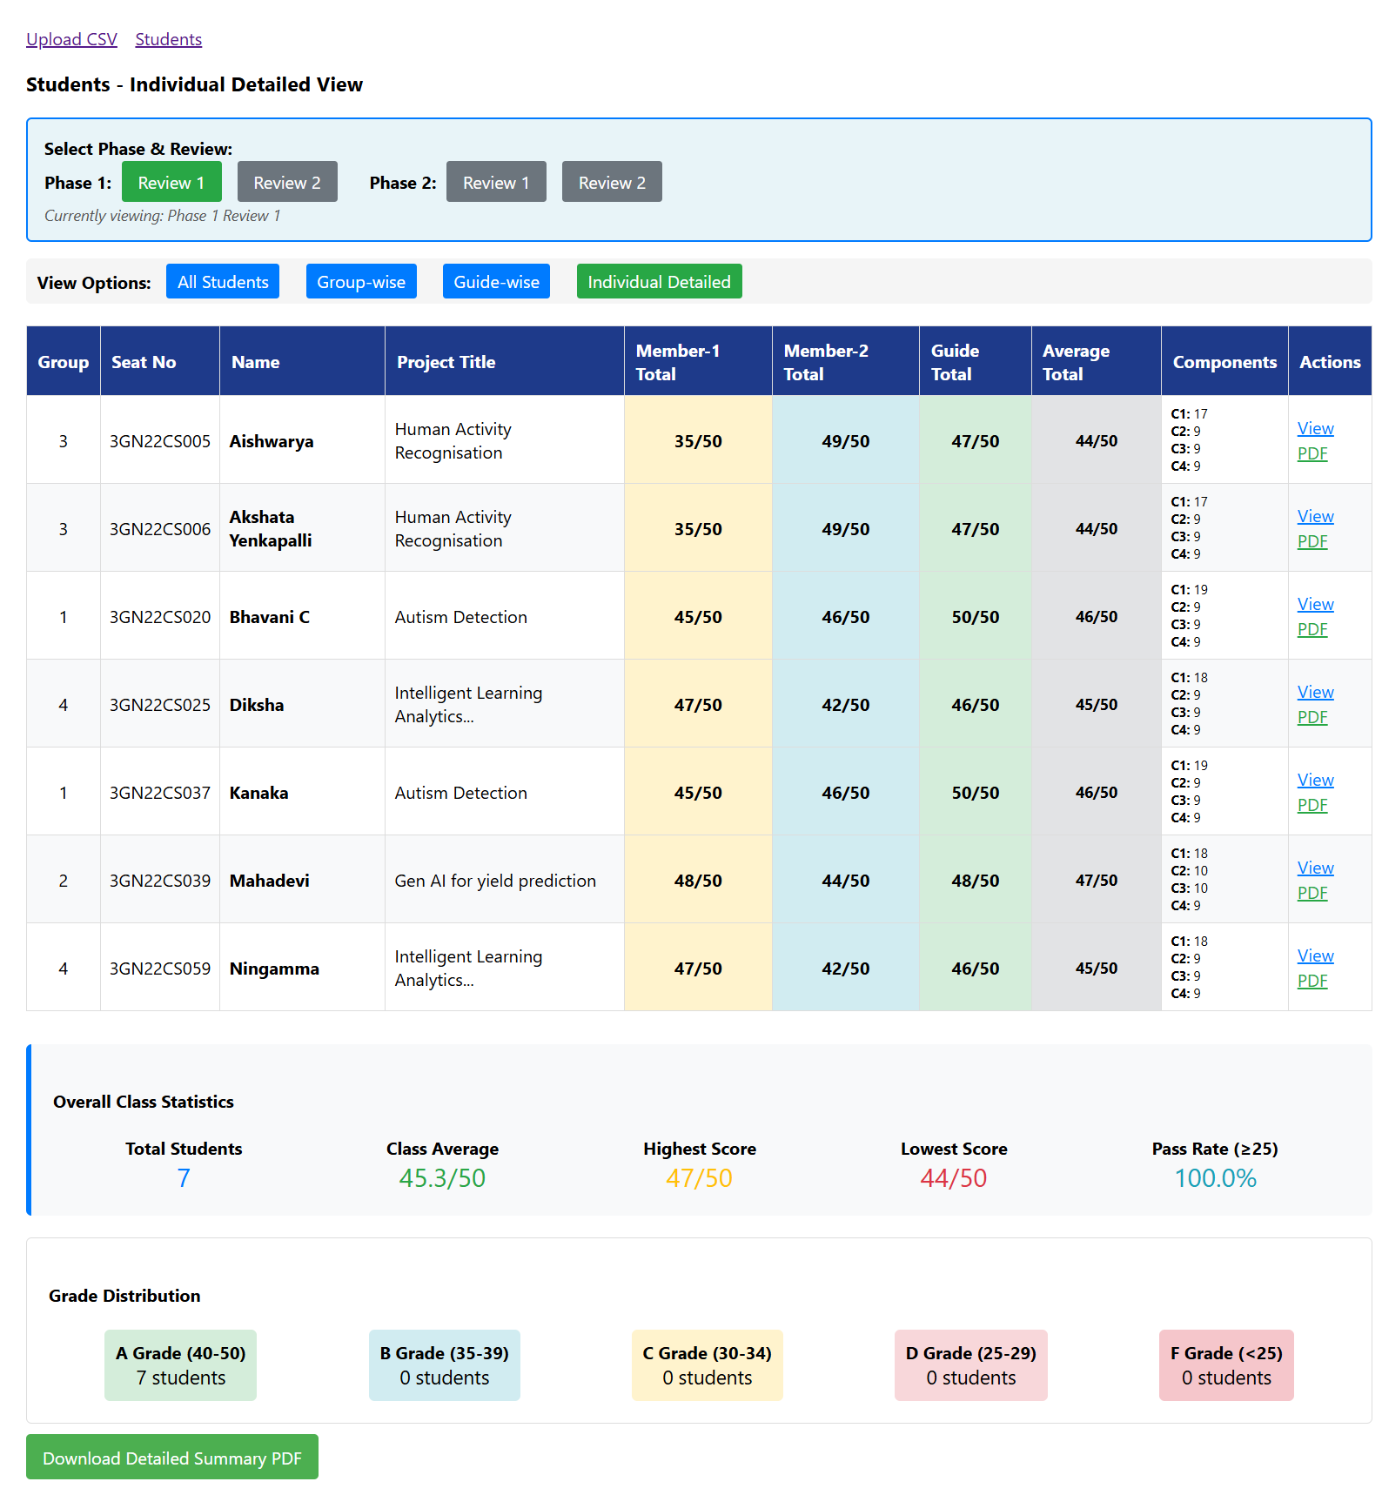

Slide 24
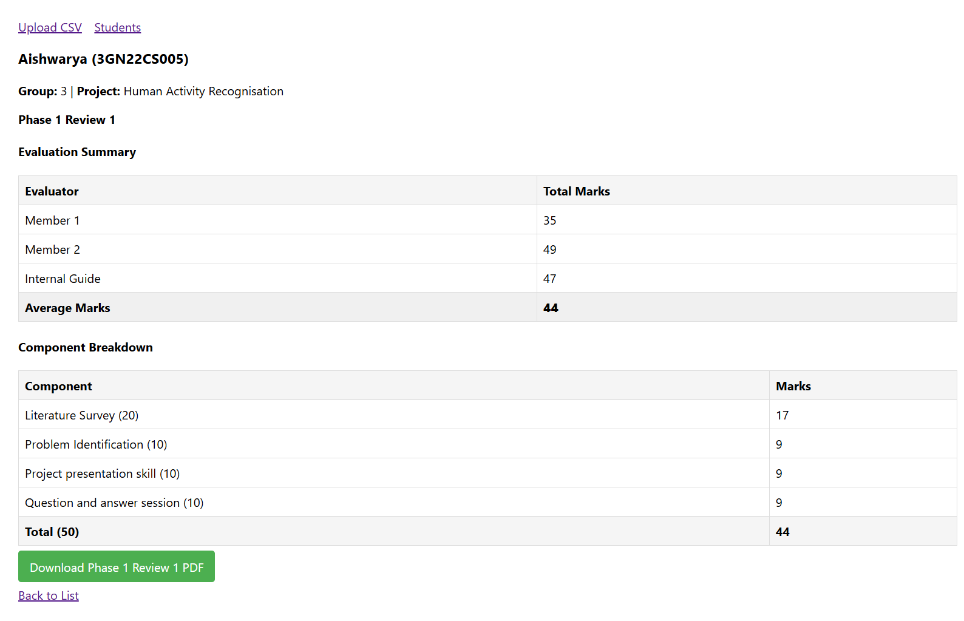

Slide 25
Conclusion and Future Scope
Conclusion :
automates project evaluation and documentation efficiently.
Current features include marks computation, Excel report generation, and record management.
Reduces manual work and ensures fair evaluation.
Future Scope :
Automatic guide assignment based on project domain and guide expertise.
Bulk download of all student reports.
AI-assisted analysis for project topic trends.
Department-level analytics and reporting dashboards.

Slide 26


